Slide 1
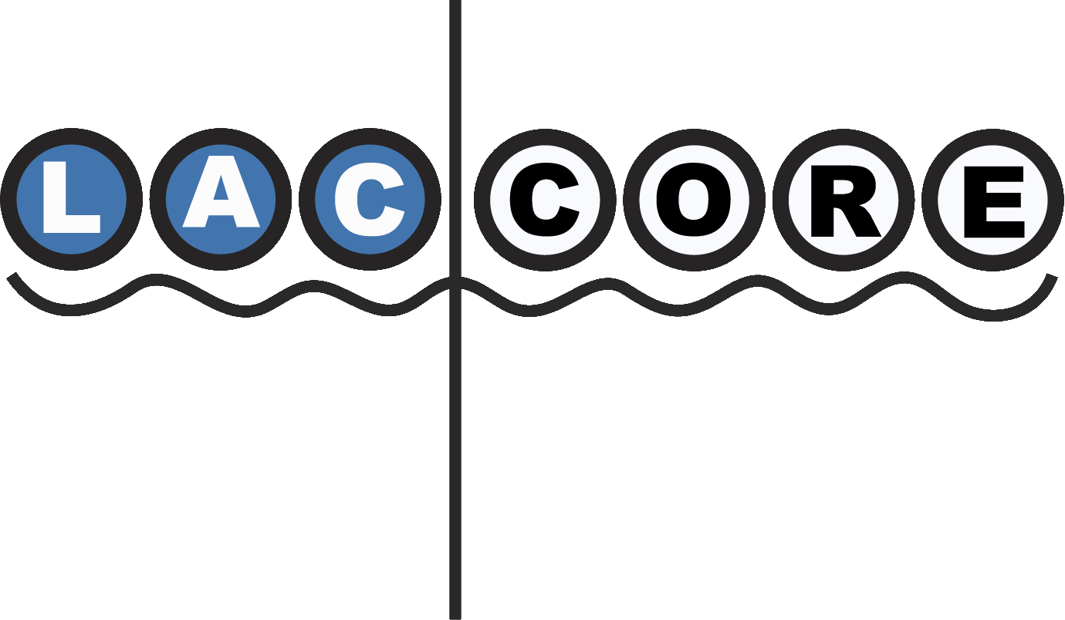
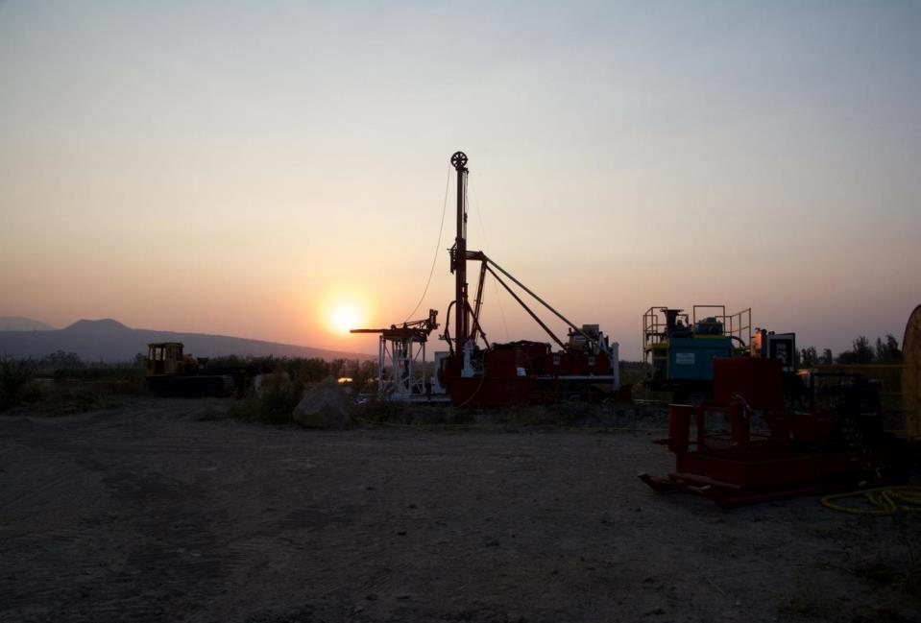
CSDCO and LacCore
Infrastructure for Drilling and Coring
Kristina Brady Shannon
Curator, Continental Scientific Drilling Coordination Office/LacCore
University of Minnesota

Slide 2
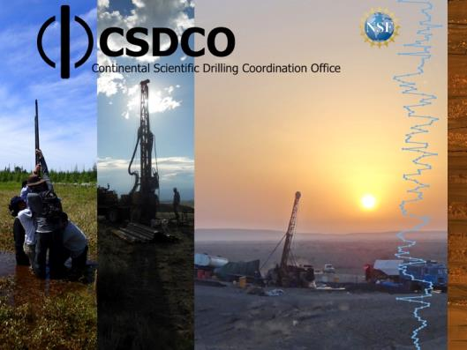
CSDCO — Continental Scientific Drilling Coordination Office
LacCore — Core Laboratory and Repository
NSF Facilities for continental scientific drilling & coring
University of Minnesota
Any scientific discipline
Any lithology
Any scale
Integrated Support
Project development
Field equipment
Operations management
Lab + instrumentation
Sample/Data repository
Cyberinfrastructure
Broader impacts
Community coordination

Slide 3
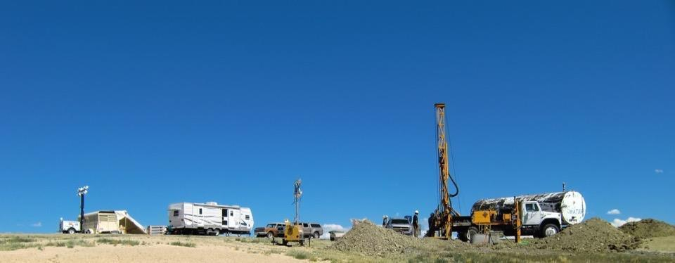
Project Development
Scientific objectives
Borehole/Cuttings/Core
Depths
Locations, access, prep
Vertical or angled boreholes
Cuttings disposal
Downhole logging
Analyses to be performed; protocol requirements; drilling fluids; tracers
Expected lithologies—site survey information, existing well logs, outcrops
Local resources: transportation, fuel, water, food, lodging, heavy equipment, contractors, personnel
Personnel travel, visas
Permitting
Season/weather
Site-specific safety
Risk management
Cultural issues
Outreach activities
Bureaucratic/political issues
Bidding
Budget + contingency
Proposals
Contracting

Slide 4
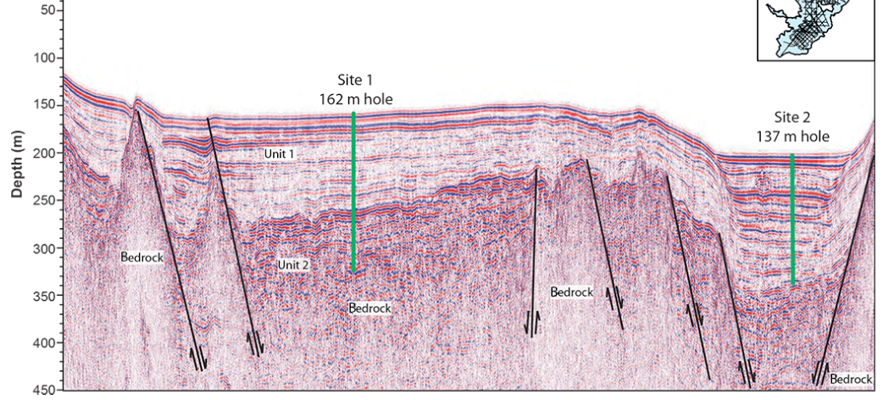
Site Surveys
Geophysical (seismic reflection, passive seismic, GPR, multibeam)
Well logs
Outcrops

Slide 5
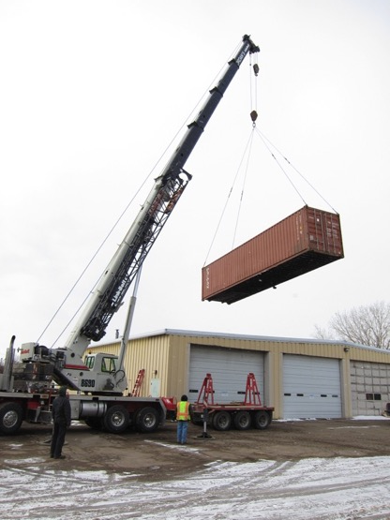
Logistics
Local customs and resources
Carnet
Local partners
US Export License requirements
Travel: immigration, visas, transportation, housing, food
Local financial transactions
Local export permit requirements
US importation requirements
Freight

Slide 6
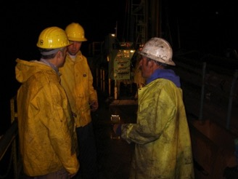
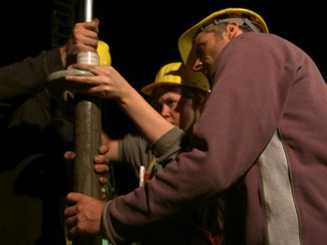
Operations Management
General Contractor
Drilling, downhole logging, accommodations, procurement, etc.
Budget management / cost control
Company rep
Institutional memory between projects
Ensures contractor follows client priorities, executes drilling plan safely and efficiently, meets goals and timelines
Provides continual communication between drillers and scientists
Drilling engineering support
Curator
Sample handling, subsampling, data capture
Outreach

Slide 7
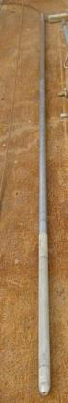
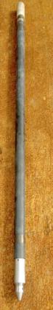
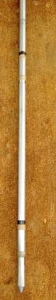
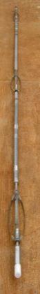
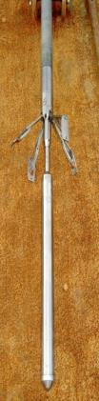
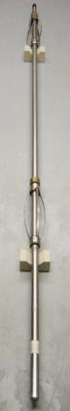
Field workflows
Downhole
Surveys
MS
SGR
DLL
BS
DIP

Slide 8
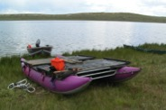
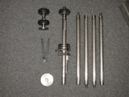
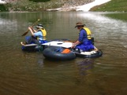
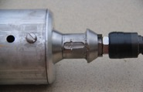
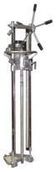
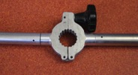
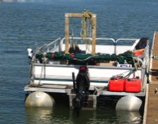
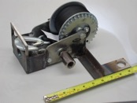
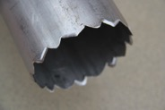
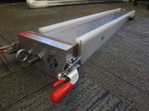
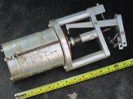
Field Support
Equipment design, sales, rental, operation/training
Surface cores: push, gravity, freeze, Eckman dredge
Long cores: Kullenberg, Livingstone, Mackereth, Nesje, vibracorer, Winkie drill
Vessels: small inflatables to large platforms

Slide 9

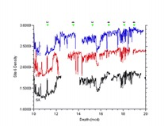
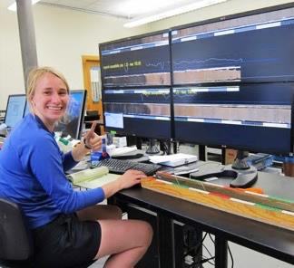
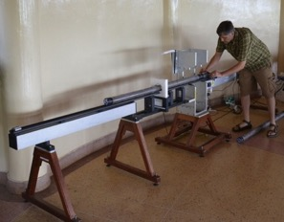
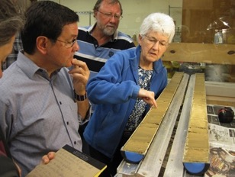
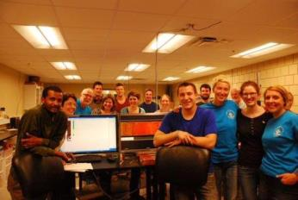
Lab
Core processing
Multisensor logging, scanning
Core splitting
Imaging
Lithologic Description
Subsampling
Analysis

Slide 10
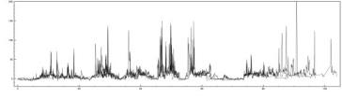
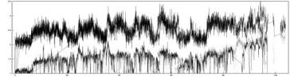
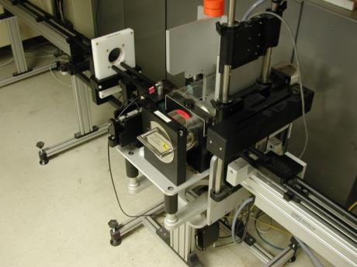
Multisensor
Logging
Geotek MSCL-S
gamma density
p-wave velocity
electrical resistivity
magnetic susceptibility (loop)
natural gamma radiation

Slide 11
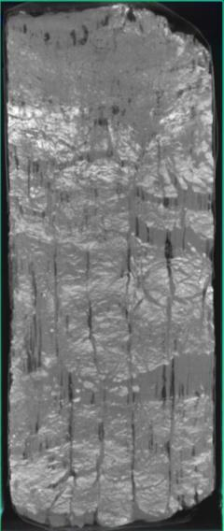
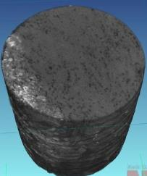
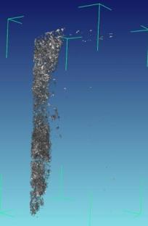
CT Scans
Toshiba Aquilion, NSI X5000

Slide 12
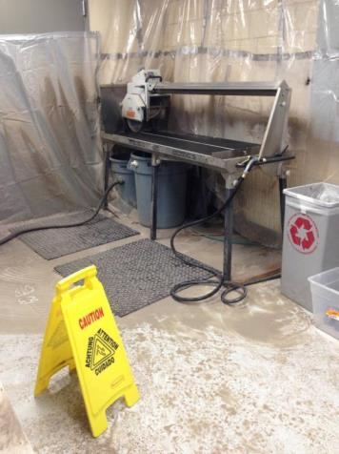
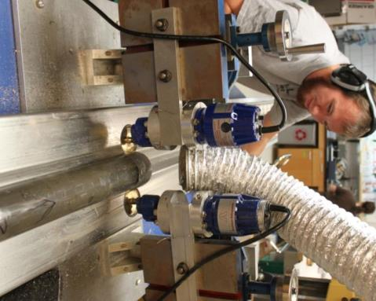
Core Splitting
Soft sediment to hard rock

Slide 13
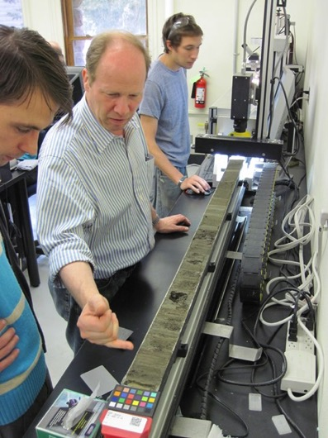
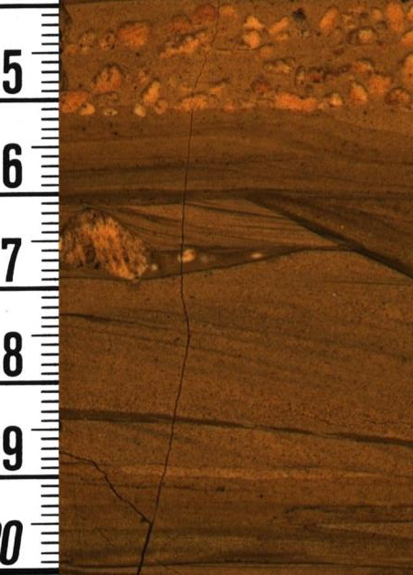
Linescan Imaging
Geotek CIS/Geoscan IV + DMT Corescan

Slide 14
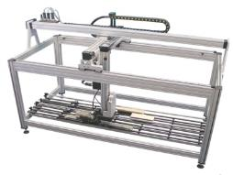
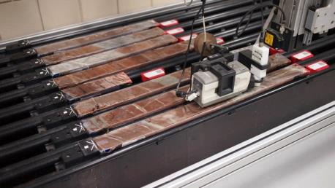
Multisensor logging
Geotek MSCL-XYZ
magnetic susceptibility (point/hi-res)
color reflectance (360-740nm) + L*a*b* and Munsell

Slide 15
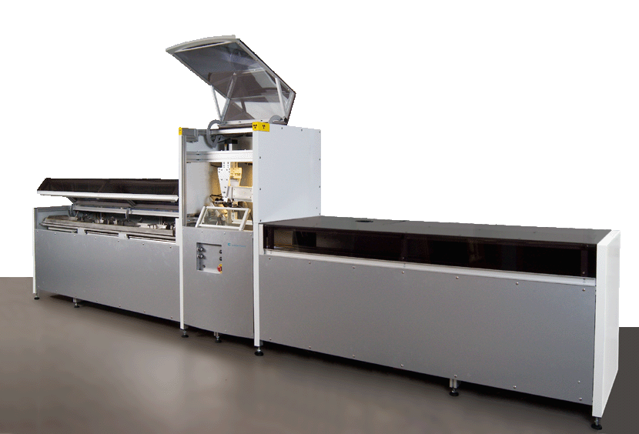
Scanning XRF
X-radiography
ITRAX
Concentrations of most elements from Al to U at resolutions to 200 micron
~30 to 60 sec/sample interval
X-radiography: 200 micron resolution; 30 minutes/meter

Slide 16
Hyperspectral Imaging
Mineral maps
Unknown
Unknown
OM
Hydrous Si
Carbonate
Gypsum
Fe-Oxide
Linescan

Slide 17
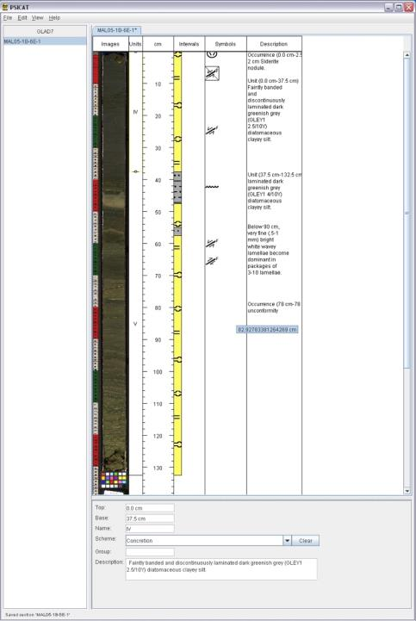
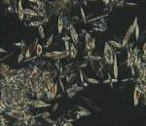
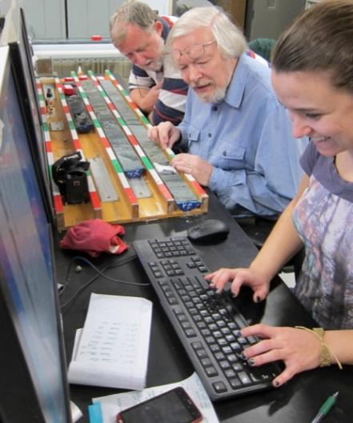
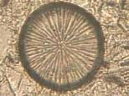
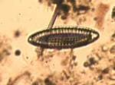
Lithologic Description

Slide 18
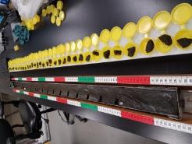
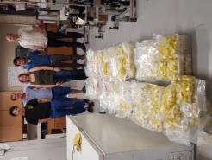
Sampling

Slide 19

Data Sharing: Open Science Framework
Web browser user interface
Individual logins managed by OSF
Activity tracking & alerts
Version control
Google drive data storage
Unlimited
Fast downloads globally
Persistence in the case of OSF going away

Slide 20

Services
Smear slides
Sampling
LOI
Grain size: laser diffraction
Grain size: wet sieve
XRD
Thin section prep
SEM / EDS
Isotopes
Diatoms
Pollen
Phytoliths
Pollen concentrate AMS 14C
Charcoal
Multisensor logging
Core splitting
Linescan imaging
XRF / X-radiography
CT scans
Lithologic description
Epoxy embedding
Coordinate other analyses:
e.g. pmag, radiometric dating
Sell specialized supplies

Slide 21


Curation
Physical Samples + Data
Storage
Refrigerated
Ambient
Frozen
Distribution
Visualization
Project Publications, Reports
Goals
Operations
Project outreach activities
Major outcomes
Lessons learned
Publications
PI-generated data
Best practices

Slide 22



Infrastructure Development
Drilling and coring tools/equipment
Winkie drill
Percussion coring system
Tool developments/mods
Deep drilling engineering
Facility Design
Lab
Repository (ambient, refrigerated, frozen)
Equipment, supplies
Office / conference, visitor workspace
Lab Instrumentation
CT scanner
XRD scanner
Hyperspectral scanner
Containerized labs

Slide 23


Repository Development
UMN purchased warehouse adjacent to campus Dec 2015
Ideal spaces for sample collections, equipment & supplies management, expedition services
Expansion +
consolidation

Slide 24



Community Engagement
Meetings / Conferences
Booth
Direct engagement
Workshops
Project focus
Domain focus
Infrastructure focus
Short courses
Travel grants
Listservs, email lists, social media

Slide 25





Community Coordination
ICDP: International Continental Scientific
Drilling Program
NSF-funded entities
IODP, CZOs, CUAHSI, EarthScope
Federal agencies
USGS, EPA, DOE, NPS, BLM, BIA, NASA, DOD
State agencies
Natural Resources/Env Protection
State Geological Surveys
Smithsonian, natural history museums
Native American Tribal governments
Industry
Municipalities

Slide 26

Graduate student training and VGSP

Slide 27

Drilling and Coring Summer Institute
Two weeks
Comprehensive
Grad students, postdocs, early career researchers
Twice per summer
Adding 1 week topical short courses in the future

Slide 28




Support for better outreach, diversity, education
Notes:
We are available to help you
Bring this experience, best practices, evaluated methods to other projects
Related to CSDCO work and based on projects we’ve collaborated on in the past
for LacCore/CSDCO customers but also for y’all if you want

Slide 29

Community-driven research (Pandya 2014)
Notes:
I’m going to start with some of the hardest
Most challenging but most important angle
The foundation of what we should be doing
What do people HERE (stakeholders) want to know? (Those people who are pissed about past shittiness – INVOLVE THEM!)
How can we build that research into our own questions?
Medical analogy/origin
Starting to make inroads into science (successfully used in [public] health)
Get much better results if you truly involve people from Day One

Slide 30


Slide 31


Community Science Planning
Workshop: November 2016
Paleorecord Community
Science Drivers: Hydroclimate, Biology/Ecology, Hazards, Paleoanthropology/Archeology
67 sites proposed
Wide community input needed
Focused workshops needed for regional prioritization
Workshop: Spring 2017
Critical Zone, Deep Biosphere, Structure,
Tectonics, Geothermal

Slide 32

Example: MexiDrill / Chalco
Drilling 2/22 - 4/2/16
800,000 year record of climate, ecology, volcanism, and seismicity from Mexico City basin
Major funding: ICDP, NSF (P2C2), UNAM (4 years of proposals)
facebook.com/MexiDrillChalco
First ICDP drilling project with full CSDCO coordination
Solicited bids from 6 commercial drilling contractors
≥ 35% drilling cost savings (≥ $285k) vs earlier budgets
4% lost days for maintenance/parts/driller errors
vs 35-65% in recent projects
Cutting edge, deeply embedded broader impacts program
Leverage ~$3M investment in lab instrumentation, tools, software for core processing, scanning

Slide 33

Example: Yellowstone Lake Hydrothermal System
Coring: September 2016
Evolution of Yellowstone hydrothermal system
Funding: NSF IES (Rob Sohn PI)
Project development
Workflow planning:
Data capture & management
Drilling performance & engineering
Subsampling
Leverage investment in lab instrumentation, tools, scanning, software

Slide 34

Example: Catalina/Jemez CZO
Valles Caldera, New Mexico
Drilling June 2016
Jon Chorover, Jen McIntosh
Project development
Workflow planning
Data capture & management
Drilling performance & engineering
Subsampling
Leverage investment in lab instrumentation, tools, scanning, software

Slide 35
Metrics
Collection
7,317 sites
34,145 core meters — tripled since 2009
Materials
Soft sediment: Continental sedimentary basins (lake, bog, river, bay/estuary, etc.)
Peat
Permafrost
Soils/regolith — CZOs
Sedimentary Rock
Crystalline Rock
Storage
Refrigerated
Ambient
Frozen

Slide 36
Metrics
Annually
380 unique individuals from 110 institutions visit for 1,300 visits
1,300 unique individuals from 430 institutions supported in total for more than 12,500 contacts
2011-16
428 journal articles published from supported projects
812 projects supported
627 graduate students, 768 undergraduate students, and 52 high‐school students trained/mentored
15 major drilling campaigns supported in the field and lab
81 field campaigns total directly supported for 1,648 staff-days
163 field campaigns rented equipment
12,434 meters of core were processed for 297 projects
478 sample requests filled (each 10 to 10,000 samples)
74% of projects archived cores in repository
174 sets of lake sediment coring equipment sold
355 orders filled for specialized field and lab supplies
1,410 shipments of cores, samples, supplies, and equipment
8 core collections accessioned; 6 more in preparation

Slide 37
Personnel
UMN-Twin Cities
Anders Noren, CSDCO Director (PI)
Emi Ito, LacCore Director (PI)
Amy Myrbo, Research Associate; Director of Outreach, Diversity, & Education (PI)
Jessica Heck, Lab and Finance Manager
Kristina Brady Shannon, Curator
Ryan O’Grady, Operations and Infrastructure
Alexander Morrison, Data Manager and Developer
Mark Shapley, Research Associate
Shane Loeffler, Graduate Research Assistant / Flyover Country
Sijia Ai, Flyover Country Developer
Jane Franklin, Financial Administrator
Alex Gjorvad, Technician
Sarah McNamara, Technician
TBN, Technician
Contractors
Brian Grivna, Applications Developer
Doug Schnurrenberger, Drilling Supervisor
UMN-Duluth
Erik Brown, XRF Lab Director (PI)
Aaron Lingwall, XRF Lab Manager

Slide 38

CSDCO.org
LacCore.org

Slide 39


Facility Move: August 2017

